Slide 1

Gen-AI

Slide 2
Day 4 - Python

Slide 3

Syllabus
Pre Training – Functions, Modules, Packages, Libraries, Framework, Platform
Training
1. Topics: Defining functions, lambda functions, import modules.
2. Hands-On: Write functions for calculating statistics (mean, median).
Post Training – Case Study: Write a script that imports a module to analyze customer survey

Slide 4
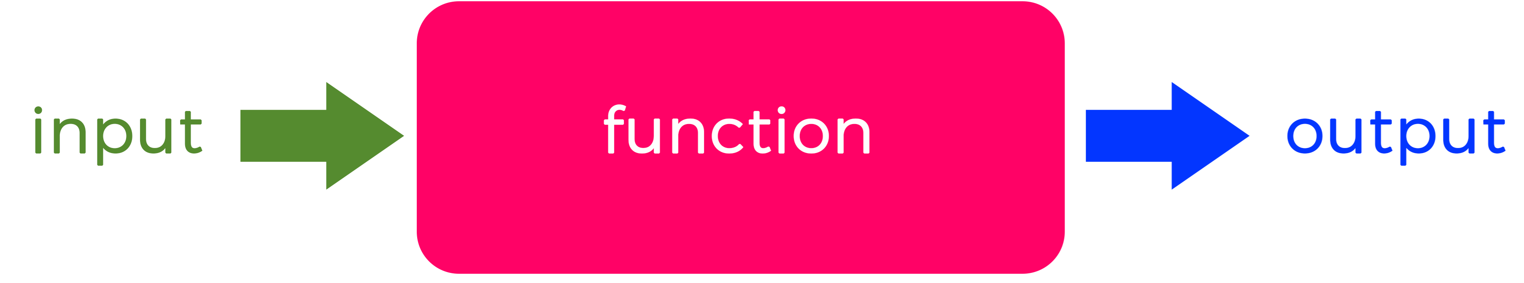
What is a Function in programming
Definition: A function is a block of code that performs a specific task and can be used multiple times
Purpose: Functions are used to break down large problems into smaller, more manageable chunks.
Advantage: Functions can be reused, which saves time by reducing code repetition, make code cleaner, organized, modular and easier to maintain
Working :Functions take in data, process it, and return a result. They can be called by other parts of program, and parameters can be passed into them.
Other terms: Functions are also known as procedures, methods, subroutines, routines, or subprograms.

Slide 5
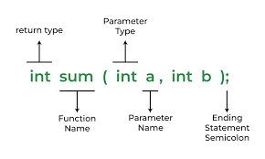
Key features of Functions
Encapsulation: A function groups a set of instructions together, abstracting complexity and making the code easier to read.
Reusability: You can call a function multiple times without rewriting the same code.
Modularity: Functions break a program into smaller, manageable pieces.
Maintainability: Since functions are independent, making changes to a function doesn’t usually affect the rest of the program.
Isolation: Functions can help isolate variables and logic, reducing the chance of errors and easy debugging.

Slide 6
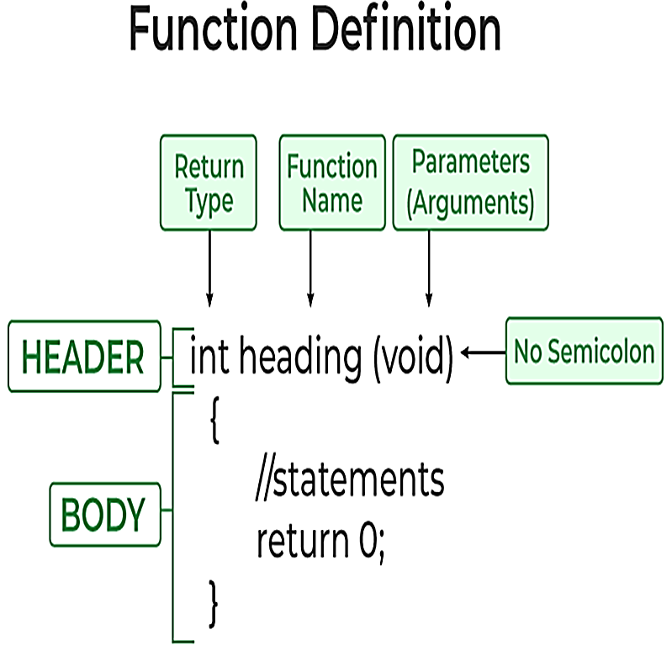
Components of a Function
Function Definition: Specifies the name of the function, its parameters, and the code it will execute.
Body: Contains the code that performs the specific task.
Function Call: Executes the function, optionally passing arguments and receiving results.
Parameters/Arguments: Input values that the function uses during execution.
Return Value: The output of the function. Some functions may not return a value but perform actions like printing to console

Slide 7
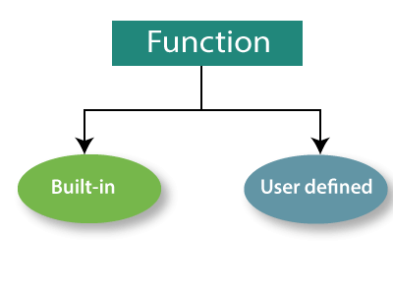
Types of Functions
1. Built-in Functions: These are pre-defined functions provided by programming languages. They simplify coding by allowing developers to execute common operations without coding them from scratch. Ex: print(), len()
2. User-defined Functions: These are functions created by the programmer to perform specific tasks tailored to their needs. User-defined functions enhance the flexibility of the code and allow for custom operations.

Slide 8
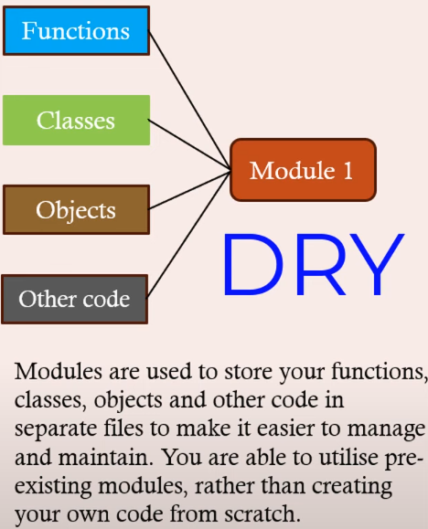
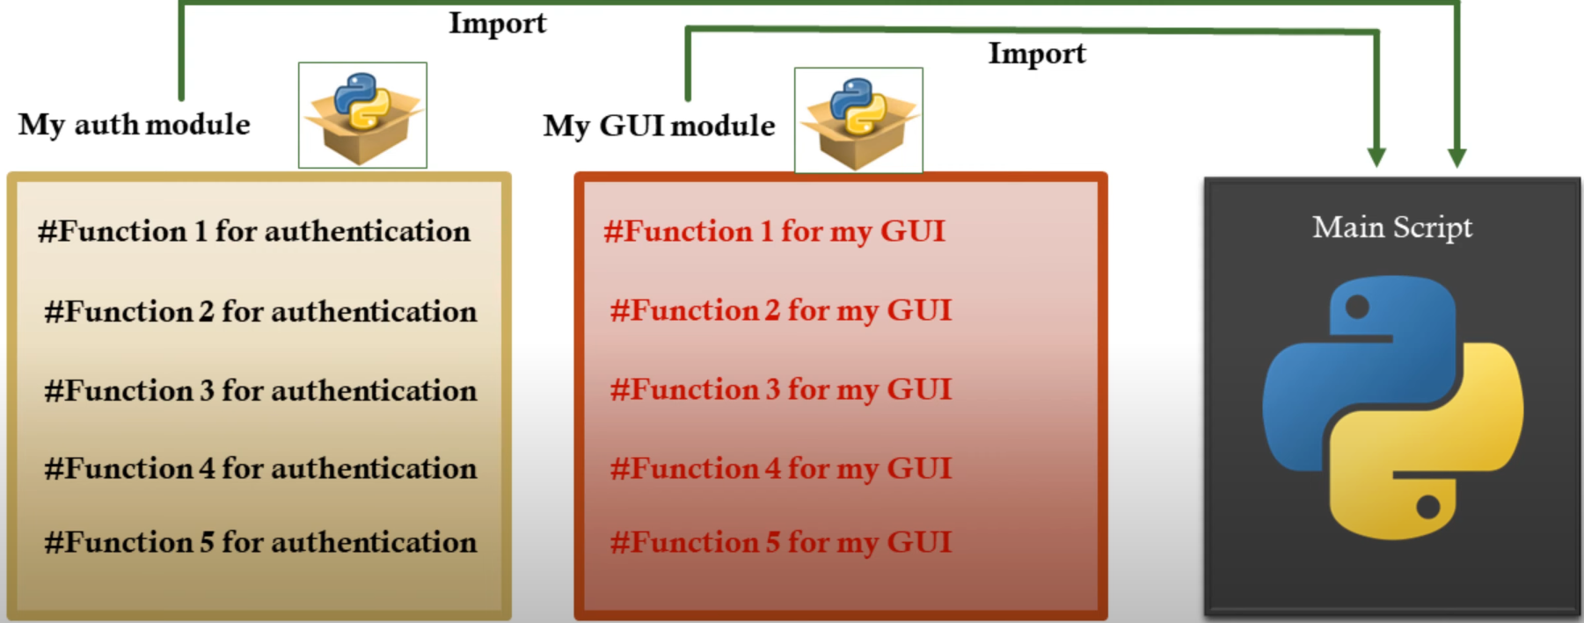
Modules – Do not Repeat Yourself

Slide 9
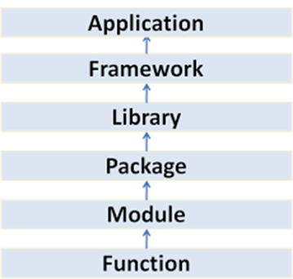
What is a Module
English definition: Module is an assembly of parts designed to be added and removed from a larger system easily
Programming definition: Module is a file that contains a collection of related code, such as functions, classes, or variables, to perform specific tasks and can be reused in other programs.
Advantage: Modules help organize code into logical units, making it easier to maintain, understand, and reuse.
Reuse: Module can be imported for use as a whole or only a single function.
Python has no main function or method. Instead, there is a main module. The main module is the source file that runs first. Whatever file you give to the interpreter at startup becomes main. It doesn’t matter the name of the file.

Slide 10
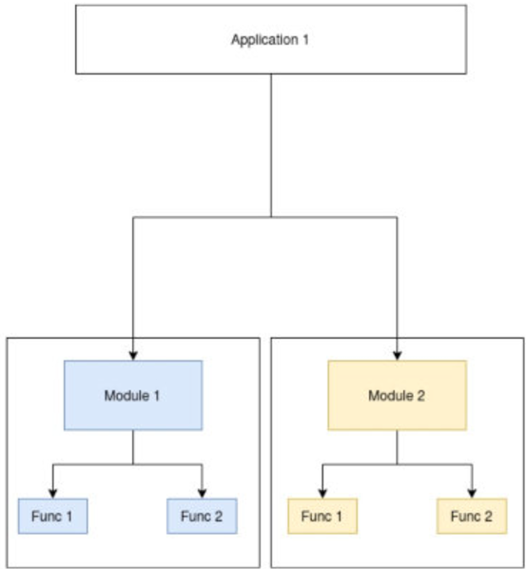
Key features of a Module
Organization: Modules help organize code by grouping the related functions, variables, and other resources together.
Reusability: Modules can be used in multiple programs without duplication by allowing developers to write code once and use it in multiple programs.
Build, test, and debug: Each module can be built, tested, and debugged independently.
Dependencies: One module can use another module as a dependency.
Object-oriented programming: in OOPS, modules usually correspond to classes, packages, files, and components.
Namespace Management: Modules provide a separate namespace to avoid naming conflicts.
Maintainability: Code changes in a module do not affect other parts of the program

Slide 11
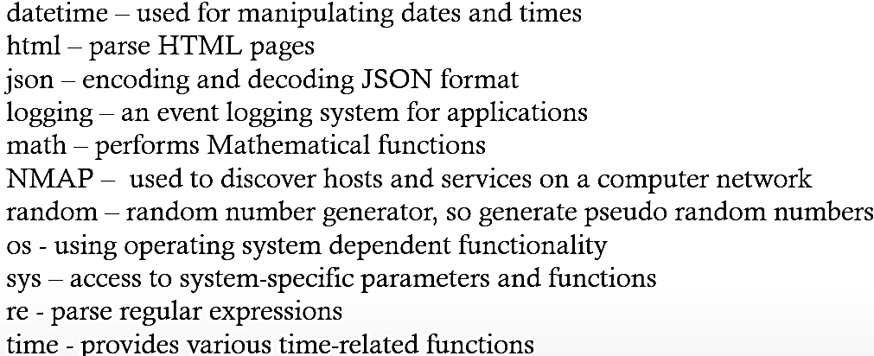
Types of Modules
Built-in Modules: Standard library provided by the programming language. Example in Python: math, os, datetime.
User-defined Modules: Created by developers to organize their code. Example: A file named utilities.py in Python with custom functions and classes.
Third-party Modules: Developed by others and often installed via package managers. Example in Python: numpy, pandas.
https://docs.python.org/3/py-modindex.html

Slide 12
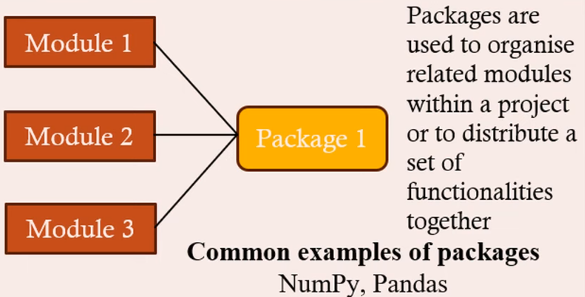
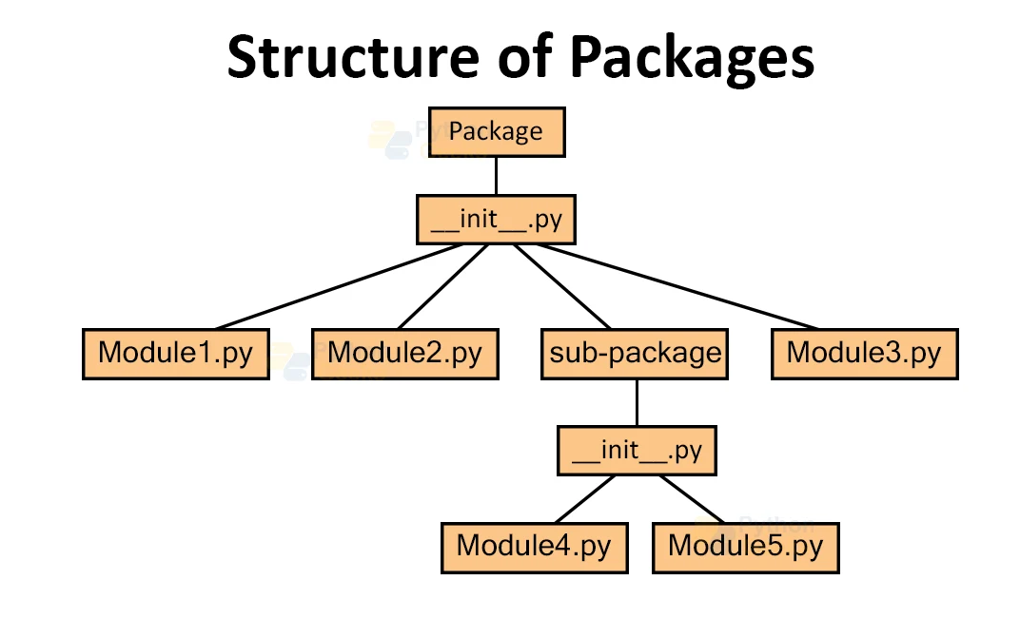
Packages

Slide 13
What is a Package
A package is a namespace that collects and organizes a set of related files, directories, classes and interfaces that are required for a running a software.
They are usually designed and built by the application developer after the application code has been developed.
Software packaging is the process of bundling various software components, configuration files and documentation into a single package, to facilitate the distribution and installation of the software on multiple systems.
A software package can be licensed, downloaded or subscribed to as a bundle of related products.
https://pypi.org/

Slide 14
Key features of Packages
Structure: A package consists of a directory containing one or more modules and a special file, often called __init__.py in Python, which makes the directory a package. The __init__.py file can be empty or include initialization code for the package.
Namespaces: Packages create namespaces, which help avoid conflicts between module names. For example, you can have modules with the same name in different packages without any collision.
Hierarchy: Packages can contain sub-packages, forming a hierarchical structure, for a more organized and logical grouping of related functionality.
Distribution: Packages are often used to distribute libraries and frameworks. Ex: Python's pip tool install packages from the Python Package Index (PyPI).

Slide 15
Key features of Packages
Built-in Packages: These are predefined packages provided by programming languages or frameworks. Ex: In Python, built-in packages like math and os.
User-defined Packages: Developers can create their own packages to organize their code according to specific project needs. Ex: A package named myapp.utilities can contain various utility functions relevant to the application 35.
Benefits of using Packages
Avoid Naming Conflicts: By grouping classes into packages, developers can use the same class names in different contexts without conflict 12.
Enhanced Code Maintenance: Code organized into packages is easier to maintain and update since related functionalities are grouped together 45.
Simplified Access Control: Packages provide controlled access to classes and interfaces, allowing developers to expose only those that are necessary while keeping other parts private.

Slide 16
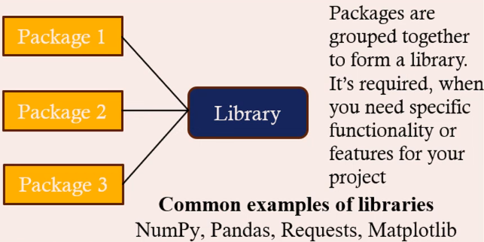
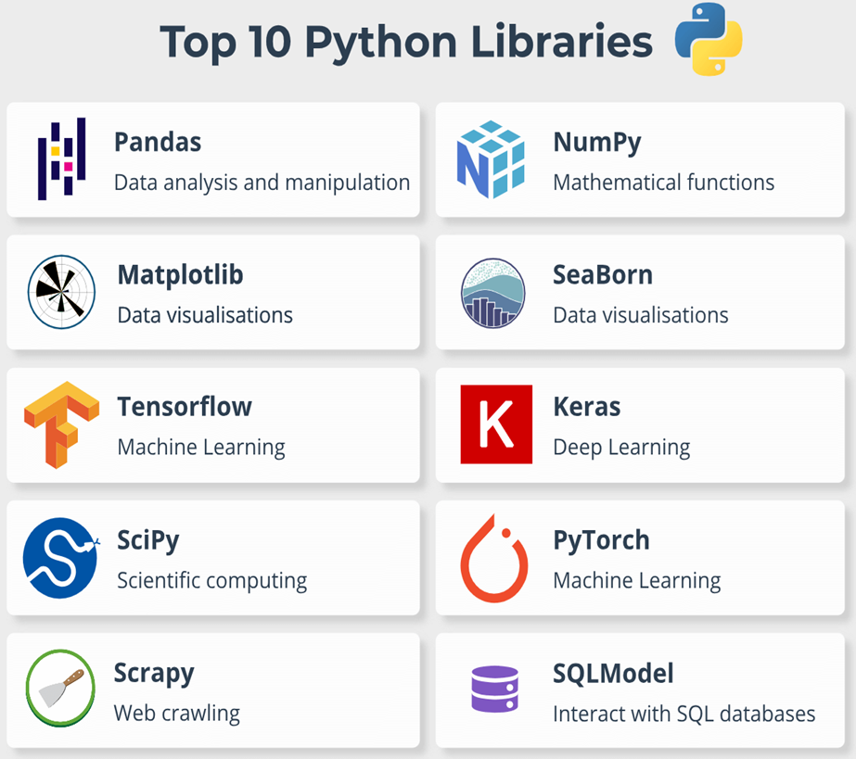
Libraries

Slide 17
What is a Library in programming
A library is a curated collection of pre-written or precompiled code files, functions, modules, scripts, routines, and other resources that can be referenced by programmers, for software development, to reduce the amount of code a programmer needs to write.
Libraries are essential tools that make programming more efficient and allow developers to leverage the work of others to build more complex and robust applications.
Python libraries: NumPy for numerical operations, Pandas for data manipulation, Requests for making HTTP requests.

Slide 18
Types of Libraries
Standard Libraries: These are built-in libraries that come with a programming language. They provide essential functions and utilities that are commonly used across various applications. Ex: Python Standard Library: Offers modules for file I/O, system calls, and data manipulation.
Third-party Libraries: Developed by individuals or organizations outside the core language developers, these libraries offer additional functionalities not included in the standard library. Ex: NumPy: A library for numerical computations in Python, TensorFlow: A library for machine learning developed by Google.
Dynamic and Static Libraries:
Dynamic Libraries: Loaded at runtime, allowing programs to use the library without recompiling if updates occur (e.g., .dll files in Windows).
Static Libraries: Compiled into the program’s executable code at compile time, making the application self-contained (e.g., .lib files)..

Slide 19
Key features of Libraries
Reusable Code: Libraries encapsulate commonly used functions and routines, making it easier to reuse code across different programs and projects.
Efficiency: Using a library can significantly speed up development time, as you don't need to reinvent the wheel for standard operations. This allows you to focus on the unique aspects of your application.
Quality and Reliability: Libraries are often developed and maintained by experienced programmers and communities, which means they are usually well-tested and reliable.
Modularity: By using libraries, you can keep your code modular and organized. This helps in maintaining and scaling your applications.
Variety: There are libraries available for almost every aspect of programming, including data manipulation, web development, machine learning, graphics, and more.

Slide 20
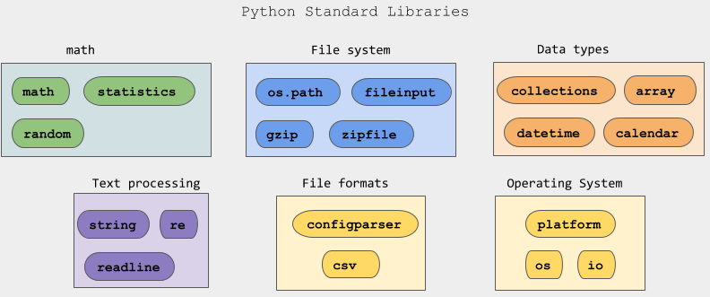
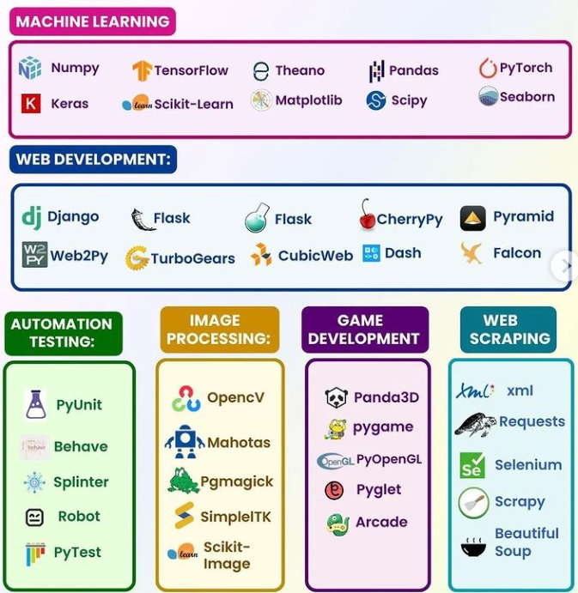
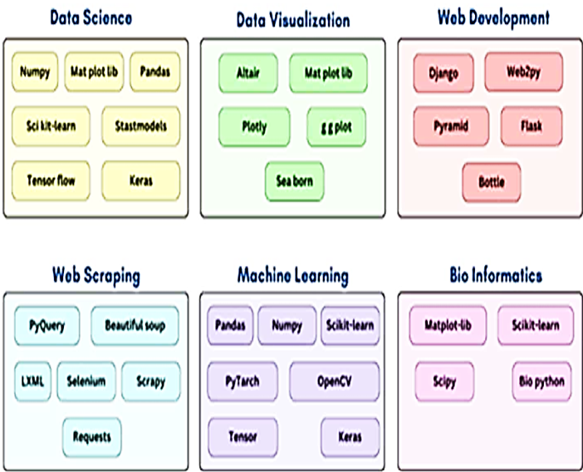
Libraries

Slide 21
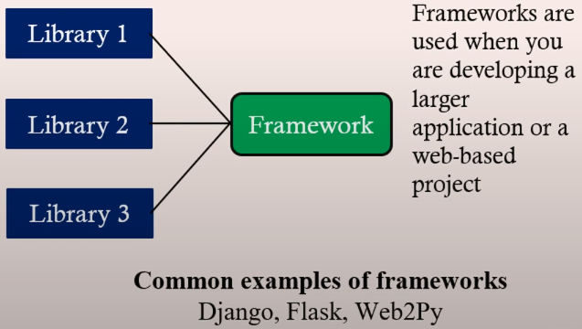
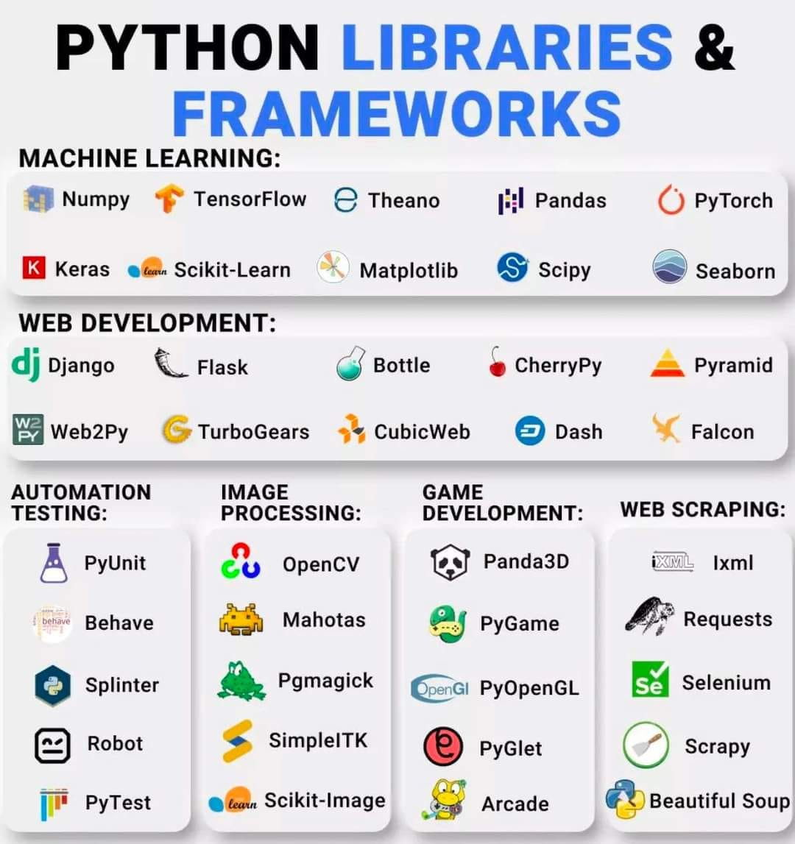
Framework

Slide 22
What is a Framework
A framework is a is a pre-defined structure environment that provides a collection of reusable components which includes templates, convenience functions, and access to tools like libraries, compilers, and support programs to help developers build new applications more efficiently.
Standardization: Frameworks enforce certain coding standards and best practices, promoting consistency and maintainability in codebases. However, developers can extend frameworks by adding custom code while adhering to the framework's architecture and guidelines.
Frameworks typically consist of several key components:
APIs (Application Programming Interfaces): Protocols that allow different software components to communicate with each other.
Code Libraries: Collections of pre-written code that developers can invoke to perform specific tasks.
Compilers: Tools that translate source code into executable files.
Debuggers: Utilities that help identify and fix errors in code

Slide 23
Key features of a Framework
Structure: Frameworks provide a structure and set of rules for developing software, which helps maintain consistency and organization in large projects.
Pre-built components: Frameworks come with pre-built components, such as libraries and modules, that handle common tasks (e.g., database access, user authentication), allowing developers to focus on the unique aspects of their application.
Code reusability: Using a framework encourages code reuse, as developers can leverage the built-in components and patterns provided by the framework.
Scalability: Frameworks are designed to handle large-scale applications, offering features that help manage complexity and scale with growing demands.
Efficiency: By providing a ready-made structure and tools, frameworks speed up the development process and reduce the amount of boilerplate code developers need to write.
Community and Support: Popular frameworks have large communities that contribute to their improvement and provide support through forums, documentation, and tutorials.

Slide 24
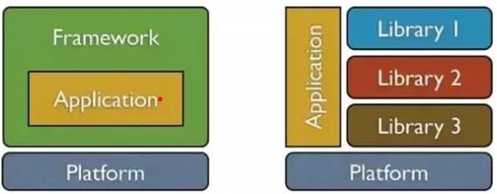
What is a Platform
A platform is a software environment or hardware that provides tools, libraries, and resources for developing and running software applications. Ex: Azure, .NET
Software platform: An environment for writing and running applications that includes tools like compilers, GUI builders, and utilities. They are designed to support multiple programming languages, engines, and web services. Ex: .NET
Coding platform: A customized hardware or software environment that allows programmers to code. Ex: Google Collab.
Operating system (OS): The OS is a software platform that is responsible for the functioning of in-built apps and third-party applications on devices like computer or Mobile. Ex: Linux, Window, Mac, Android

Slide 25
Key features of a Platform
Environment: Provides the necessary environment to run software applications.
Development tools: Includes compilers, interpreters, debuggers, and libraries to aid rapid development.
Hardware or Software: Platforms can be physical (hardware) or virtual (software environment)
Interoperability: Defines how applications interact with the operating system and other software.
Efficiency in development: By providing pre-defined structures and tools, platforms help developers create applications more quickly and efficiently.
Standardization: Platforms enforce coding standards & best practices across all projects
Scalability: Platforms offer features that allow applications to easily scale as per user demand
Support: Platforms have extensive documentation & community forums that provide support for developers.

Slide 26
Key features of a Platform
Operating Systems: They provide the necessary services and interfaces for applications to interact with hardware. Ex: Windows, macOS, Linux, and Android.
Hardware Platforms: They refer to the physical hardware on which software runs, such as desktops, laptops, servers, and mobile devices.
Runtime environments: They provide the necessary environment for executing programs written in specific languages. Ex: Java Runtime Environment (JRE) for Java applications, .NET Framework for applications written in .NET languages.
Development Platforms: They provide tools like built-in libraries, compilers, debuggers tools and environments used to develop software. Ex: Integrated Development Environments (IDEs) like Visual Studio or Eclipse.
Cloud Platforms: They offer infrastructure and services over the internet, allowing developers to build, deploy, and manage applications without worrying about the underlying hardware. Ex: AWS, Microsoft Azure, and Google Cloud Platform.

Slide 27
Defining functions
# 1. Simple Function
def greet(name):
"""
Returns a greeting message.
Parameters:
name (str): The name of the person to greet.
Returns:
str: A greeting message.
"""
return f"Hello, {name}!"
# Example usage
print(greet("Alice")) # Output: Hello, Alice!
# 2. Function with Parameters
def add_numbers(a, b):
"""
Adds two numbers.
Parameters:
a (int or float): The first number.
b (int or float): The second number.
Returns:
int or float: The sum of the two numbers.
"""
return a + b
# Example usage
print(add_numbers(3, 5)) # Output: 8
# 3. Function with Default Parameters
def greet_with_default(name="Guest"):
"""
Returns a greeting message with a default name.
Parameters:
name (str): The name of the person to greet. Defaults to "Guest".
Returns:
str: A greeting message.
"""
return f"Hello, {name}!"
# Example usage
print(greet_with_default()) # Output: Hello, Guest!
print(greet_with_default("Alice")) # Output: Hello, Alice!
# 4. Function with Variable-Length Arguments (*args)
def add_all(*args):
"""
Adds all the numbers provided as arguments.
Parameters:
*args (int or float): A variable-length list of numbers.
Returns:
int or float: The sum of all the numbers.
"""
return sum(args)
# Example usage
print(add_all(1, 2, 3, 4)) # Output: 10
# 5. Function with Variable-Length Keyword Arguments (**kwargs)
def display_info(**kwargs):
"""
Displays information provided as keyword arguments.
Parameters:
**kwargs: A dictionary of keyword arguments.
Returns:
None
"""
for key, value in kwargs.items():
print(f"{key}: {value}")
# Example usage
display_info(name="Alice", age=30)
# Output:
# name: Alice
# age: 30
# 6. Function with No Parameters
def say_hello():
"""
Returns a simple greeting.
Returns:
str: A greeting message.
"""
return "Hello!"
# Example usage
print(say_hello()) # Output: Hello!
# 7. Function with a Return Statement
def multiply(a, b):
"""
Multiplies two numbers.
Parameters:
a (int or float): The first number.
b (int or float): The second number.
Returns:
int or float: The product of the two numbers.
"""
return a * b
# Example usage
result = multiply(3, 4)
print(result) # Output: 12
# 8. Lambda Function (Anonymous Function)
square = lambda x: x ** 2
"""
An anonymous function that calculates the square of a number.
Parameters:
x (int or float): The number to square.
Returns:
int or float: The square of the input number.
"""
print(square(5)) # Output: 25

Slide 28
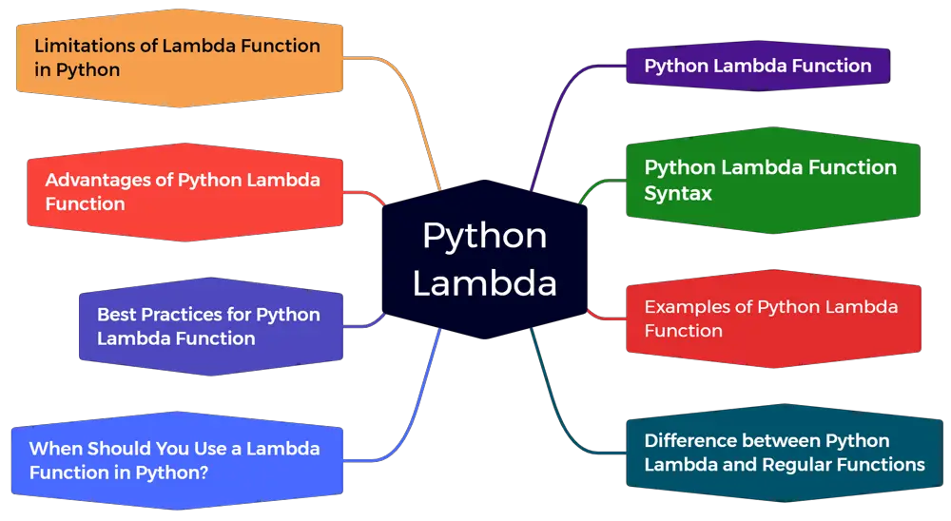
Lambda functions

Slide 29
Lambda functions
Lambda functions are anonymous functions, without a name.
They are created using the lambda keyword and are typically used for short, simple operations.
They are often used when you need a function for a short period.
Key characteristics:
Single Expression: Lambda functions can only contain a single expression. You cannot include multiple statements or commands.
Inline Definition: They are written in a single line.
No Name: They are unnamed, hence "anonymous."

Slide 30
Lambda functions
# Example 1: Basic lambda function to double a number
double = lambda x: x * 2
print("Double of 5:", double(5)) # Output: 10
# Example 2: Using lambda with map to square numbers
numbers = [1, 2, 3, 4, 5]
squared = map(lambda x: x ** 2, numbers)
print("Squared numbers:", list(squared)) # Output: [1, 4, 9, 16, 25]
# Example 3: Using lambda with filter to get even numbers
even_numbers = filter(lambda x: x % 2 == 0, numbers)
print("Even numbers:", list(even_numbers)) # Output: [2, 4]
# Example 4: Using lambda to sort a list of tuples by the second element
students = [("Alice", 85), ("Bob", 75), ("Charlie", 95)]
sorted_students = sorted(students, key=lambda student: student[1])
print("Sorted students by scores:", sorted_students)
# Output: [('Bob', 75), ('Alice', 85), ('Charlie', 95)]
# Example 5: Using lambda for an inline function to add two numbers
add = lambda x, y: x + y
print("Sum of 3 and 7:", add(3, 7)) # Output: 10

Slide 31
import modules
# Example 1: Importing an entire module
import math
# Using a function from the math module
print("Square root of 16 (math.sqrt):", math.sqrt(16)) # Output: 4.0
# Example 2: Importing specific components
from math import sqrt, pi
# Using imported components
print("Square root of 25 (sqrt):", sqrt(25)) # Output: 5.0
print("Value of pi:", pi) # Output: 3.141592653589793
# Example 3: Using an alias for a module
import numpy as np
# Using numpy with its alias
array = np.array([1, 2, 3])
print("Numpy Array:", array) # Output: [1 2 3]
# Example 4: Using an alias for a specific function
from math import sqrt as square_root
# Using the aliased function
print("Square root of 36 (square_root):", square_root(36)) # Output: 6.0
# Example 5: Importing all components (not recommended)
from math import *
# Using a function from the math module
print("Sine of pi/2 (sin):", sin(pi / 2)) # Output: 1.0
# Example 6: Using external modules (e.g., pandas)
# Uncomment the following line if pandas is not installed: pip install pandas
import pandas as pd
# Using pandas to create a DataFrame
data = {'Name': ['Alice', 'Bob'], 'Age': [25, 30]}
df = pd.DataFrame(data)
print("Pandas DataFrame:")
print(df)
# Output:
# Name Age
# 0 Alice 25
# 1 Bob 30
# Example 7: Importing a custom module (Assume mymodule.py exists in the same directory)
# Custom module content (mymodule.py):
# def greet(name):
# return f"Hello, {name}!"
# Import the custom module
# Uncomment the below code if you have the custom module
# import mymodule
# print("Greeting from custom module (mymodule.greet):", mymodule.greet("Alice")) # Output: Hello, Alice!
# Importing a specific function from the custom module
# Uncomment the below code if you have the custom module
# from mymodule import greet
# print("Greeting from custom module (greet):", greet("Bob")) # Output: Hello, Bob!
# Example 8: Reloading a module
# Uncomment the below code if you are modifying and testing a custom module
# from importlib import reload
# reload(mymodule)
# Example 9: Using random module with an alias
from random import randint as random_integer
# Generating a random integer
print("Random integer between 1 and 10 (random_integer):", random_integer(1, 10))
# Example 10: Combining various imports
print("Combination of imports example:")
print("Value of pi (from math):", pi) # Output: 3.141592653589793
print("Square root of 49 (from math):", sqrt(49)) # Output: 7.0
print("Random integer between 1 and 100 (from random):", random_integer(1, 100)) # Random Output

Slide 32
Hands-on
Write functions for calculating statistics (mean, median).

Slide 33
Case Study
Write a script that imports a module to analyze customer survey

